Slide 1
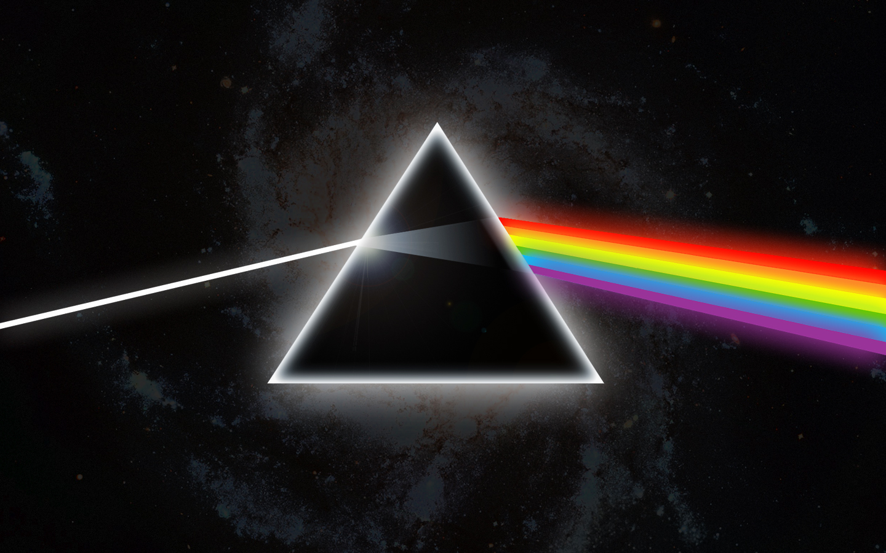
How Music Affects the Brain !

Slide 2
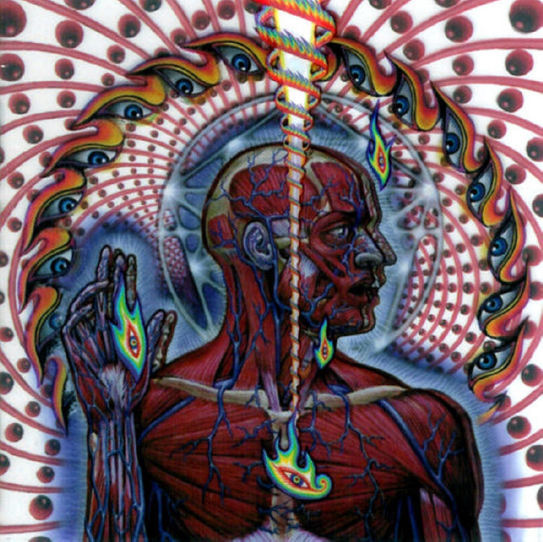
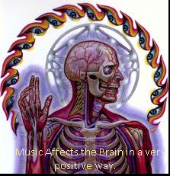
Music Affects the Brain in many different positive ways.
Notes:
Music does have positive effects on the brain,such as pain management;Music can help reduce the sensation and the distress of both chronic pain and postoperative pain.

Slide 3
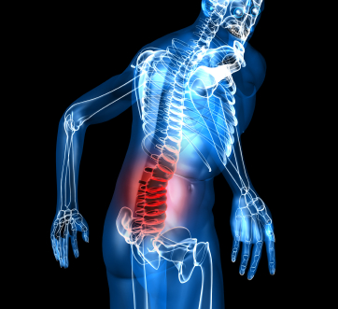
Music Heals !
Music is an effective therapy for pain management, also reduces blood pressure, Speeds up post-stroke recovery, chronic headaches and migraines remedy, and also boosts the immune system.

Slide 4
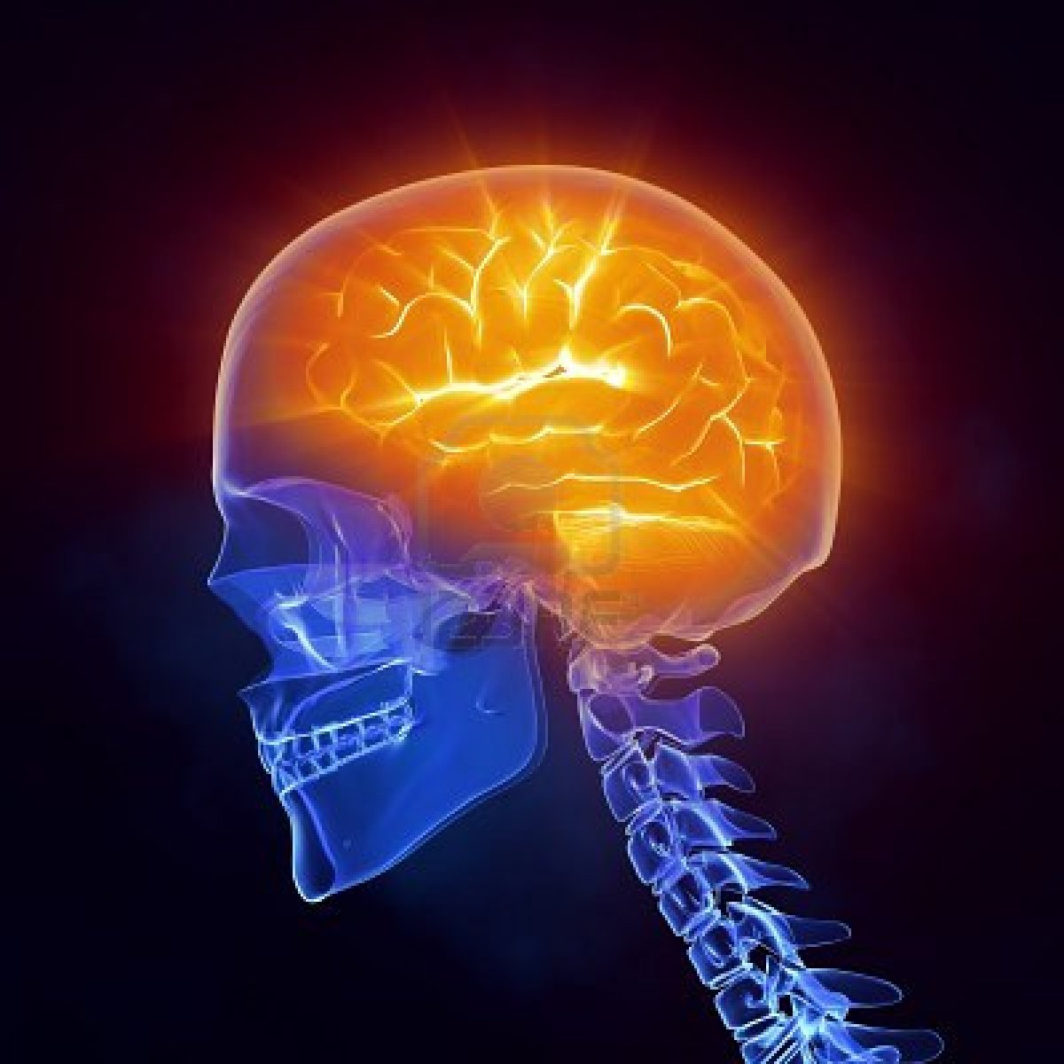
Music Makes You Smarter!
Music enhances intelligence, learning, and even I.Q, Music improves memory, performance, concentration and even attention
Music has the power to enhance some kinds of higher brain function:
Mathematical abilities , and Emotional intelligence.
Reading and literacy skills
, Spatial-temporal reasoning

Slide 5
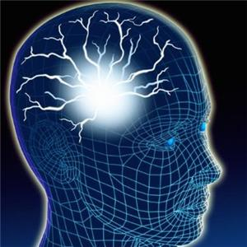
Constant worrying, anxiety, and depression can all create a very chaotic situation in the brain, which can slow down your over all working power, reasoning ability, and execution of conventional tasks becomes difficult.
It happens because of reduced levels of serotonin. 50 million of the brain cells are affected by levels of serotonin. Music effects a steep rise in the levels of serotonin, which has positive influences on brain cells controlling mood, sexual desires and processes, memory power and learning, temperature regulatory mechanism of the body, sleep and memory functions.

Slide 6
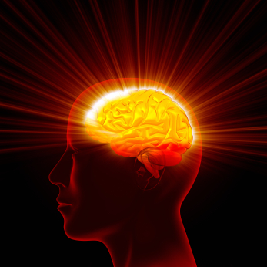
For many years, Music has been scientifically proven to be a very effective therapy for treating :
Seizures, Depression, ADD, insomnia, or even premature infancy.

Slide 7
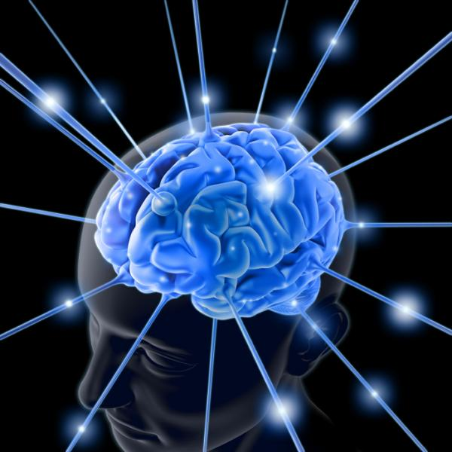
Music Helps to Recall Memories !
Still, performing music has been proven to increase memory and language skills, but for listeners, it's better used as a means to recall memories, and even restore cognitive function, for patients with Alzheimer's disease.
Back in the 1990’s , there were reports that said if you studied while listening to “Mozart” , it would increase the likeliness of doing well on a test, but it has been disproven in
Some studies,
Particularly when studying numbers or lists.

Slide 8
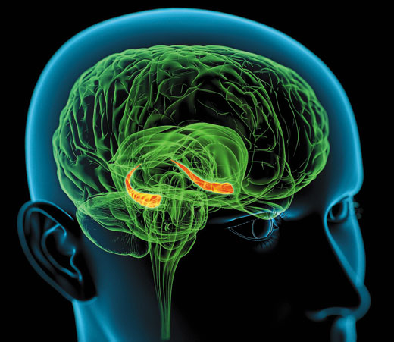
When you listen to music you know, it stimulates the hippocampus, which handles long-term storage in the brain. Doing so can also bring out relevant memories you made while listening to a particular song. So, even though the Mozart-effect has essentially been disproven, the idea that forming a new memory with music, and then using the same music again later to recall the memory still appears to be a sound idea. If you're having trouble remembering something, you might have better luck if you play the same music you were listening to when you first made the thought.
Music Stimulates the Hippocampus !

Slide 9
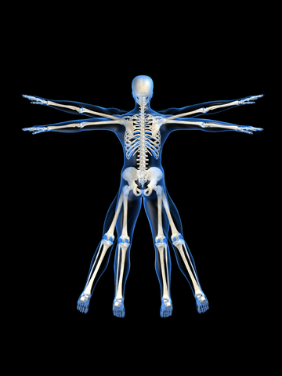
Music Improves Physical Performance !
Music improves physical and athletic performance, body movement and coordination.
The four main reasons explaining music's effects on exercise performance include:
Reduction in levels of fatigue, Increase in levels of Psychological arousal, Physiological relaxation response, and Improvement in motor coordination.

Slide 10
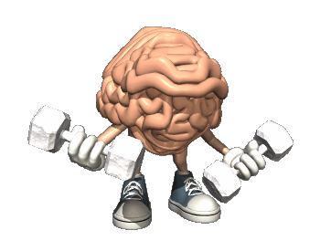
Studies conducted by sports psychologists have determined that music has a great impact on the performance level of an athlete. It has been suggested that the correct type of music can heighten an athlete’s performance by up to twenty percent!
Synchronous music, music that has a clear and steady beat, was what was shown to elevate a person’s performance by twenty percent whereas asynchronous music, background music, was shown to calm the nerves of athletes by as much as ten percent

Slide 11
Music helps to work more productively !
Listening to music can be a great way to find some extra energy. Music can effectively eliminate exercise enduced fatigue.
While there may be many reasons for wishing to be able to listen to music in the workplace, it really improves your productivity anywhere!
Notes:
According to a report in the journal Neuroscience of Behavior and Physiology , a person's ability to recognize visual images, including letters and numbers, is faster when either rock or classical music is playing in the background

Slide 12
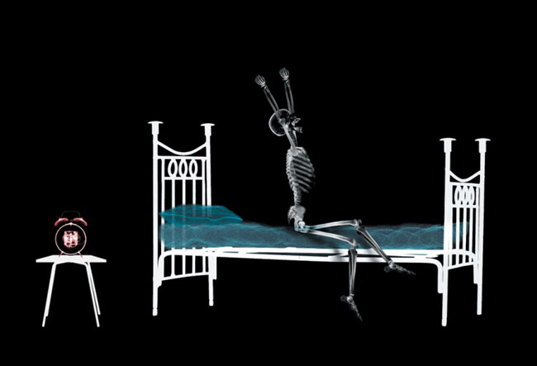
Music calms, relaxes, and helps to sleep !
Relaxing music induces sleep, and reduces levels of stress and aids in the relaxation process(physical relaxation, aids in stress relief activities, and reduces Negative
emotions)

Slide 13
Music improves the mood and decreases Depression – A.K.A. “A Prescription for the Blues”.
Many people believe that music can lift your spirits, Modern research tends to confirm music's psychot-herapeutic benefits.

Slide 14
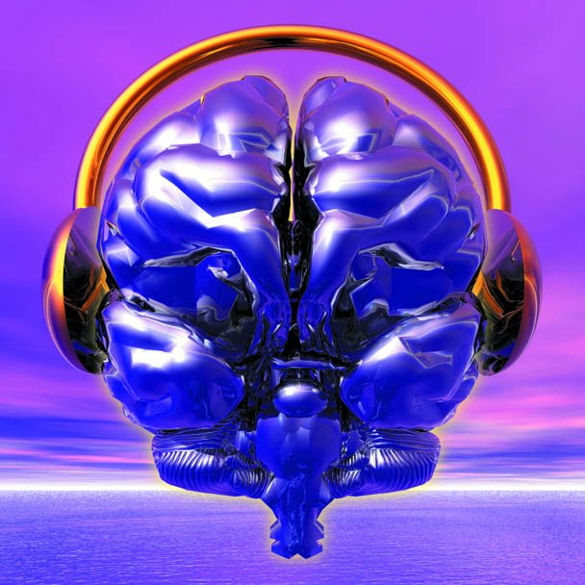
Music Stimulates BOTH sides of the Brain; simultaneously !
Research has shown that neither cerebral hemisphere is totally "dominant" for music, but rather that both hemispheres are involved,which maximizes the power of the brain!

Slide 15
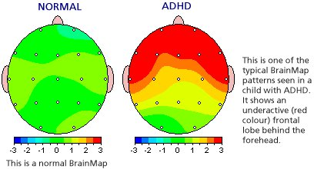
Music helps increase brain activity and performance in people with ADHD, who otherwise have an extremely hard time concentrating and being able to focus for longer periods of time. Music has these benefits:
Ability to study for longer periods of time
Improves test scores
Cuts learning time
Calms hyperactive children and adults
Reduces errors
Improves creativity and clarity
Heals the body faster
Integrates both sides of the brain for more efficient learning
Raises IQ scores 9 points (research done at University of California, Irvine)

Slide 16
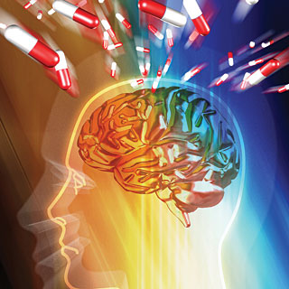
What ADHD or ADD Is and Why It Needs Treatment
Many pharmaceutical drugs have been created to treat ADHD, though the safety and effectiveness of these drugs is really not yet proven. The only drug that has been around long enough to understand long-term effects is Ritalin and it has been proven to be dangerous and lead to addiction tendencies. However, most doctors and educators push to treat these children with mind-altering drugs so they fit into the norm. Often, more than one drug is prescribed and children end up on a “cocktail” of drugs.
Don’t get me wrong, I believe ADHD does need treatment – but not with mind-altering drugs that have known side effects and unknown long-term health hazards. I believe that music can really improve a persons a brain function with ADHD, and I’m a prime example. I’ve been obsessed with music since I was about 15 or 16 years old, and I’m now 22 years old and I like to think I have been able to control my ADHD since I was about 17 or 18. It probably took me about a couple of years to understand that music affects the brain in a way that prescription drugs just doesn’t do!
Did you know – many ADHD drugs can cause:
Depression
Suicidal Thoughts and Tendencies, and
Heart Attacks ?

Slide 17
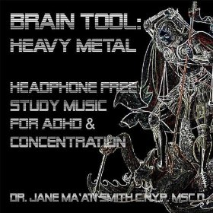
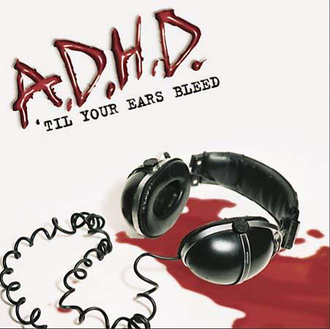
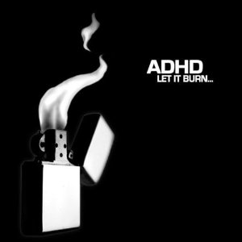

Slide 18
A wise man once said to me, “If you give a man a fish, he will be able to eat for a day, if you teach
the man how to fish, he will eat for a lifetime!”
If you just treat ADHD with prescription pills, your only treating it with a “fish”, but if you teach the person with ADHD how they can control their disabilities, you are teaching them “how” to fish, giving them tools for a whole lifetime! Music can treat ADHD better than any pills, in MY opinion, and is easily 100 times healthier and has NO side effects!

Slide 19
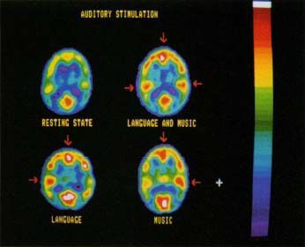
Music is almost twice as simulating to the brain as rest or sleep would be, while language and music together is more confusing to the brain
This is Your Brain on Music !
Music has the ability to activate both the left, and the right side of the brain at both times, allowing for maximum efficiency and maximum brain stimulation.

Slide 20
Music can help to reduce levels of anger, stress, fatigue, headaches and depression, so when your feeling angry or stressed-out, go play some of your favourite music and see how well you will relax!
There are several theories about how music positively affects perceived pain:
* 1. Music serves as a distracter
* 2. Music may give the patient a sense of control
* 3. Music causes the body to release endorphins to counteract pain
* 4. Slow music relaxes person by slowing their breathing and heartbeat
Music Calms the Soul !

Slide 21
Does Music really effect Plant growth ?
Well, yes, it could be said that music does affect plant growth. It is just like what music therapy is for human beings.

Slide 22
Impact of Music on Plants !
Various experiments are a major evidence of the fact that music, does in fact affect plant growth. Dorothy Retallack published a small book on this, in 1973, which was based on her experiments of the music effects on plants, in a Colorado College, in Denver. She found out that, out of the plants in three different chambers, with different conditions, those exposed to soothing music grew better than the others. In one case, the plants had bent towards the music playing device! These plants were lush green with healthy stems.

Slide 23
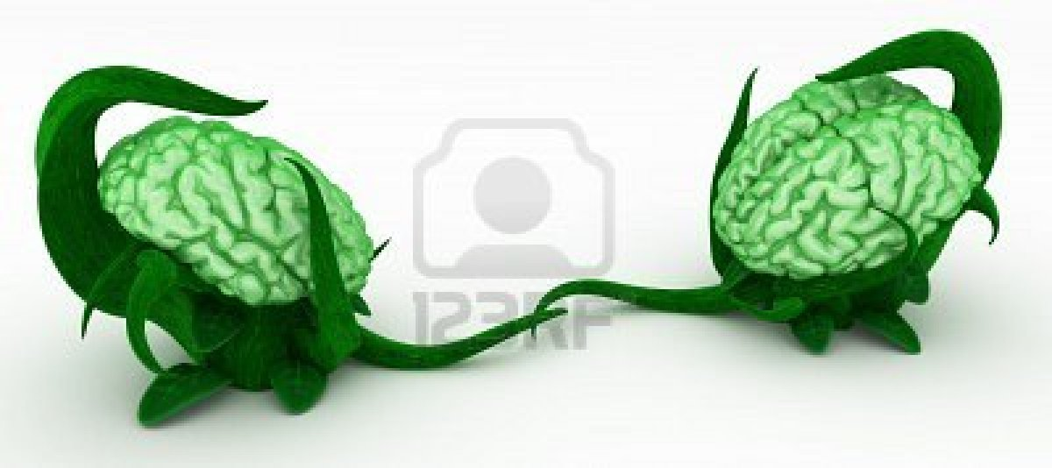
Music has the power to increase and stabilize the growth of the human brain, as well as the growth of any plants.
Plants are kind of like a brain by themselves, they strive from the left side of the plant to the right side, trying to follow the pattern of the sun or light they are being given to grow, and a brain usually only activates the left OR the right side at one time, unless exposed to music, in which case both sides are forced to grow and mature at the same time.

Slide 24
What is the Actual Effect that Music has on Pets?
In many cases, where the animal is left alone it can be beneficial to leave the radio or television on. For those animals that have a bit of anxiety, talk radio programs are a useful tool and augment some of the behavioural strategies we use. Music has a calming effect on people and scientists have notice the same influence with animals.

Slide 25
Veterinarians and Animal Behaviourist's have supported the use of relaxing music to minimize the destructive behaviours related to separation anxiety and hyperactivity.

Slide 26
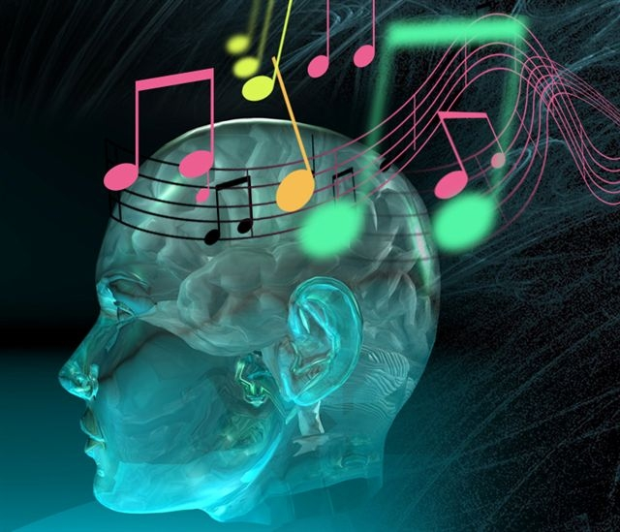
I’ve learned a lot about how music affects the brain, plants, animals, and I am very surprised about the amount of information I’ve learned.
The similarities between the Human Brain, Plants and Animal’s brains, are very interesting in the way they all perform exponentially better in many different ways.

Slide 27
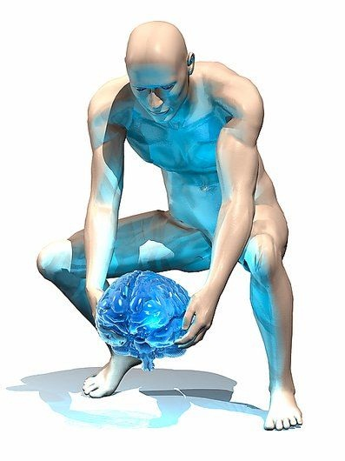
Listening to relaxing, calming music, can give a person an understanding of who they are and how they fit into the world. When something gives your brain the benefit of activating both sides at once, it’s almost like finding a new brain or new person within your previous self.
Music has the ability to give people, plants, and animals a very positive beneficial effect that in the long run will really make improvements in the growth and the development cycles.
Think of it like an exercise, if you use your brain a lot you can learn to control it more than it controls you, but if you try the so called “Music Therapy” , while exercising,
It is proven to increase athletic performance by up to twenty percent, so brain training is just as important as physical training, and music Always benefits the outcome of ones abilities.
So the next time you feel like you are under performing, physically or mentally, try listening to your favourite music!

Slide 28
Information researched on this power point is cited to these following websites:
www.emedexpert.com/tips/music.shtml
www.cracked.com/article_18405_7-insane-ways-music-affects-body-according-to-science.html
http://lifehacker.com/5865032/how-music-affects-the-brain-and-how-you-can-use-it-to-your-advantage
www.reversespins.com/effectsofmusic.html
www.cerebromente.org.br/n15/mente/musica.html
www.pickthebrain.com/blog/focus-better-by-listening-to-music/
www.livescience.com/7950-music-improves-brain-function.html
http://musictherapyadhd.wordpress.com/
www.addchoices.com/music.htm
http://people.uwec.edu/rasarla/research/add/internet.htm
All Images provided by www.google.ca

Slide 29
Power Point Created By : Randall Colford – Success 20 Project

